Slide 1
Franchise Media Limited (FML)
Pitch and on-boarding

Slide 2
What is FML?
Comic / Entertainment blog site
Looks very fun to browse at
Basically has articles on how to watch certain franchise / chain of content (be it a series of movies like oceans 11 or tv shows like tvd and originals)
People (me) are always confused on the order on how they should watch it
We solve that problem by explaining it in a fun way (as mentioned in point 2)

Slide 3
Why FML?
Cause, why not?
I mean, content is the new currency
To get pocket money?
To show off as a project done in college
And not just any project, this is just huge

Slide 4
How can this be a startup?
Good question
Register ourselves as a limited company cause we ani’t an unlimited company
Since only down the road max to max we’ll have 50 people working here, its going to forever be a startup

Slide 5
Basically we’ll have five verticals
Website
Desktop
Mobile
Application (play / app store)
YouTube channel
Separate team to make the most controversial entertainment videos out there and promote our website along the way
Spotify Podcast
Extra spicy content
Social Presence
Have the most amazing entertainment page out there
@ripen for example

Slide 6
Why you should join?
Money
Linkedin
Experience
Friendship
Too slip something cool during a convo
The feeling of being responsible for hiring and offering jobs and other people’s family’s lives depending on our company will give you chills
More money

Slide 7
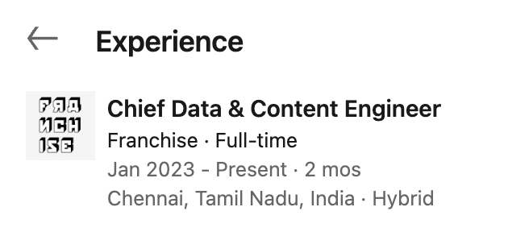
Consequences
Exhibit dekh lo:

Slide 8
Stuff we’ll have to start off with
Build the site
Make it dynamic asf
Make it responsive
Host the site
Run ads
Let people know
Wait for the ball to roll
Money flows in
Pay ourselves as salaries
Or re-invest it if you feel like it’s you baby (it is)

Slide 9
Realistic timeline
By the end of current semester, we’ll try to roll out version 1.0
User test during the sem break
Launch version 2.0 by the end of next sem
Beech mein we’ll have content team draft articles

Slide 10
Speaking of teams
Tech team
backbone
Content & outreach team
Draft articles (weekly)
Prepare podcasts (weekly)
Maintain & grow our community
Aesthetic team (me)
UI UX
Social media presence
Business & Operations
for now, me & you can both take constructive decisions.
Although it’ll be 70% you cause you’re experience will help
Search for potential investors will never stop

Slide 11
FAQs?

Slide 12
FINAL VERDICT?

Slide 13
Onboarding (initial few weeks)
Create whatsapp groups
Create slack channels
Set up weekly meetings on every sundays @ 9pm to catch up on progress
Have gmeet calls with full team hands-on every weekend
Brainstorm new ideas
Fix old ideas
Give out feedback
criticize our work so we can improve

Slide 14
Each team will have assigned work that will be visible on the company’s notion page
Proofreading will be done by the content team before publishing articles and pushing it live
Set up company’s GitHub page
Make the repo private
Share access to GitHub and LinkedIn
Share access to complete application’s codebase
View the excel file containing the roadmap and financials
Business people can handle this stuff if everything’s too much on the plate

Slide 15
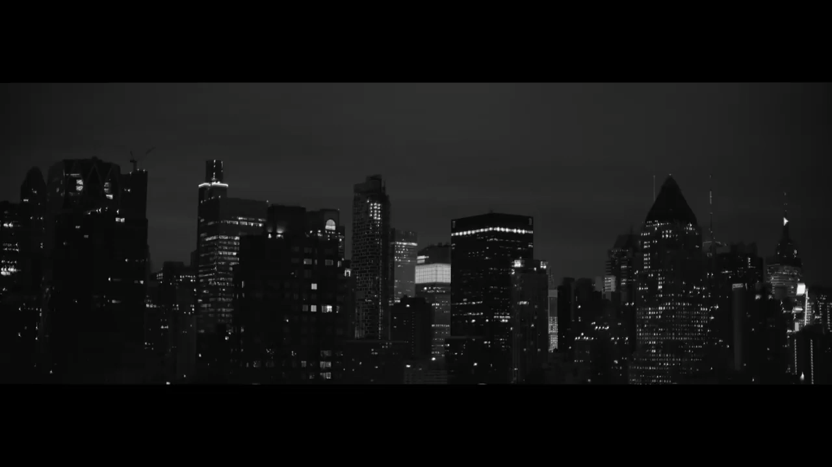

Slide 16
If anytime you find yourself asking why the heavens am I doing this, please feel free to revisit this ppt

Slide 17
Thank you. ~ sai rohit

